Slide 1
Software Evolution and Maintenance
A Practitioner’s Approach
Chapter 6
Impact Analysis
Notes:
Handouts
------------------------------------------------------------------
------------------------------------------------------------------
-------------------------------------------------------------------
--------------------------------------------------------------------

Slide 2
Outline of the Chapter
6.1 General Idea
6.2 Impact Analysis Process
6.2.1 Identifying the SIS
6.2.2 Analysis of Traceability Graph
6.2.3 Identifying the Candidate Impact Set
6.3 Dependency-based Impact Analysis
6.3.1 Call Graph
6.3.2 Program Dependency Graph
6.4 Ripple Effect
6.4.1 Computing Ripple Effect
6.5 Change Propagation Model
Notes:
Handouts

Slide 3
6.1 General Idea
The maintenance process is started by performing impact analysis.
Impact analysis basically means identifying the components that are impacted by the Change Request (CR).
Impact of the changes are analyzed for the following reasons:
  to estimate the cost of executing the change request.
  to determine whether some critical portions of the system are going to be impacted due to the requested change.
  to record the history of change related information for future evaluation of changes.
  to understand how items of change are related to the structure of the software.
  to determine the portions of the software that need to be subjected to regression testing after a change is affected.
Notes:
Handouts

Slide 4
6.1 General Idea
Implementation of change requests impact all kinds of artifacts, including the source code, requirements, design documentation, and test scenarios.
Therefore, impact analysis traceability information can be used in performing impact analysis.
Traceability is the ability to describe and follow the life of an artifact in both the forward and backward directions.
Thus, traceability helps software developers understand the relationships among all the software artifacts in a project.
There are two broad kinds of traceability:
  (i) horizontal (external) traceability.
  (ii) vertical (internal) traceability.
Traceability of artifacts between different models is known as external traceability, whereas internal traceability refers to tracing dependent artifacts within the same model.
Notes:
Handouts

Slide 5
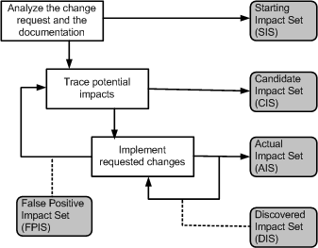
6.2 Impact Analysis Process
Starting Impact Set (SIS): The initial set of objects (or components) presumed to be impacted by a software CR is called SIS.
Candidate Impact Set (CIS): The set of objects (or components) estimated to be impacted according to a certain impact analysis approach is called CIS.
Discovered Impact Set (DIS): DIS is defined as the set of new objects (or components), not contained in CIS, discovered to be impacted while implementing a CR.
Actual Impact Set (AIS): The set of objects (or components) actually changed as a result of performing a CR is denoted by AIS.
False Positive Impact Set (FPIS): FPIS is defined as the set of objects (or components) estimated to be impacted by an implementation of a CR but not actually impacted by the CR. Precisely, FPIS = (CIS U DIS) \ AIS.
  where U denotes set union and \ denotes set difference.
In the process of impact analysis it is important to minimize the differences between AIS and CIS, by eliminating false positives and identifying true impacts.
Figure 6.1 Impact analysis process ©IEEE, 2008
Notes:
Handouts

Slide 6
6.2 Impact Analysis Process
Two traditional information retrieval metrics:
Recall: It represents the fraction of actual impacts contained in CIS, and it is computed as the ratio of |CIS ∩ AIS| to |AIS|.
  The value of recall is 1 when DIS is empty.
Precision: It represents the fraction of candidate impacts that are actually impacted, and it is computed as the ratio of |CIS ∩ AIS| to |CIS|.
  For an empty FPIS set, the value of precision is 1.
Note that if AIS is equal to CIS, both recall and precision are computed to be equal to 1.
Adequacy and effectiveness are two key aspects of any impact analysis approach.
Notes:
Handouts

Slide 7

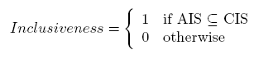
6.2 Impact Analysis Process
Adequacy
Adequacy of an impact analysis approach is the ability of the approach to identify all the affected elements to be modified. Ideally, AIS CIS.
Adequacy is repressed in terms of a performance metric called inclusiveness, as follows:
The concept of adequacy is essential to assessing the quality of an impact analysis approach.
An inadequate approach is in fact useless, as it provides the maintenance engineer with incorrect information.
For example, if inconclusive is 0, the approach cannot be used because it does not provide the maintenance engineer with all the components to be analyzed.
Notes:
Handouts

Slide 8
6.2 Impact Analysis Process
Effectiveness
The ability of an impact analysis technique to generate results, that actually benefit the maintenance tasks, is known as its effectiveness.
Effectiveness is expressed in terms of three fine grained characteristics as follows:
  Ripple-sensitivity : implies producing results that are influenced by ripple effect.
  Sharpness: is the ability of an impact analysis approach to avoid having to include objects in the CIS that are not needed to be changed.
  Adherence: is the ability of the approach to produce a CIS which is as close to AIS as possible.
Notes:
Handouts

Slide 9
6.2.1 Identifying the Starting Impact Set (SIS)
Impact analysis begins with identifying the SIS.
The CR specification, documentation, and source code are analyzed to find the SIS.
It takes more efforts to map a new CR’s “concepts” onto source code components (or objects).
It is difficult to fully automate the concept assignment problem because programs and concepts do not occur at identical levels of abstractions, thereby necessitating human interactions.
Notes:
Handouts

Slide 10
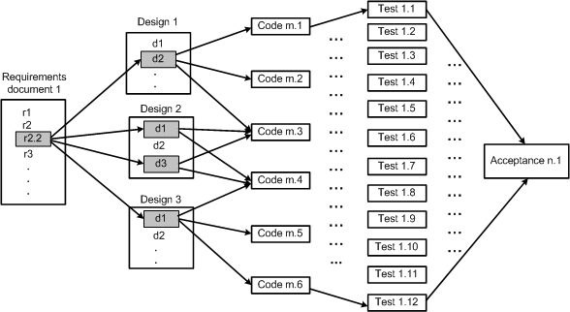
6.2.2 Analysis of Traceability Graph
The graph shows the horizontal traceability of the system.
The graph that is so constructed reveals the relationships among work products.
Figure 6.2 Traceability in software work products ©IEEE, 1991
Notes:
Handouts

Slide 11
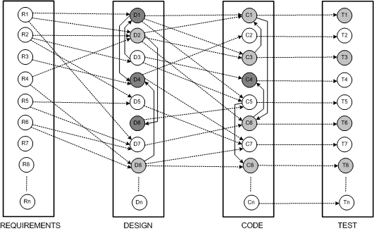
6.2.2 Analysis of Traceability Graph
The graph has four categories of nodes: requirements, design, code, and test.
The edges within a silo represent vertical traceability for the kind of work product represented by the silo.
If some changes are made to requirement object “R4,” the results of horizontal traceability and vertical traceability are shown in Figure 6.4.
The horizontally traced objects have been shown as lightly shaded circles, whereas the vertically traced objects have darkly shaded circles.
Figure 6.3 Underlying graph for maintenance ©IEEE, 1991
Notes:
Handouts

Slide 12
6.2.3 Identifying the Candidate Impact Set
A CIS is identified in the next step of the impact analysis process.
The SIS is augmented with software lifecycle objects (SLOs) that are likely to change because of changes in the elements of the SIS.
Changes in one part of the software system may have direct impacts or indirect impacts on other parts.
  Direct impact: A direct impact relation exists between two entities, if the two entities are related by a fan-in and/or fan-out relation.
  Indirect impact: If an entity A directly impacts another entity B and B directly impacts a third entity C, then we can say that A indirectly impacts C.
Notes:
Handouts

Slide 13
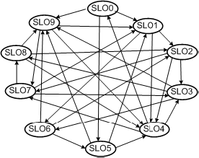
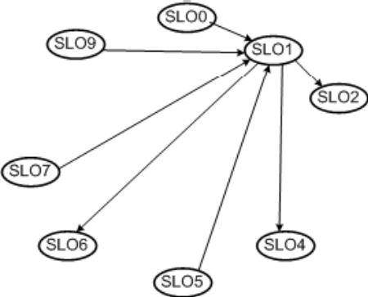
6.2.3 Identifying the Candidate Impact Set
let us consider the directed graph in Figure 6.5 with ten SLOs.
Each SLO represents a software artifact connected to other artifacts.
Dependencies among SLOs are represented by arrows.
In the figure, SLO1 has an indirect impact from SLO8 and a direct impact from SLO9.
The in-degree of a node i reflects the number of known nodes that depend on i.
Figure 6.5 Simple directed graph of SLOs ©IEEE, 2002
Figure 6.6 shows the four nodes – SLO0, SLO5, SLO7 and SLO9 – that are dependent on SLO1, and the in-degree of SLO1 is four.
In addition, the out-degree of SLO1 is three.
Figure 6.6 In-degree and out-degree of SLO1 ©IEEE, 2002
Notes:
Handouts

Slide 14
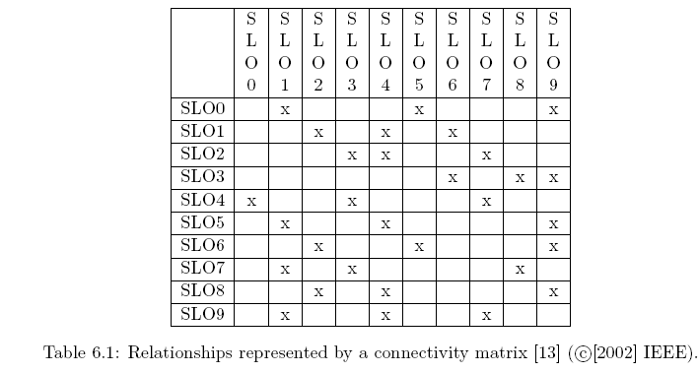
6.2.3 Identifying the Candidate Impact Set
The connectivity matrix of Table 6.1 is constructed by considering the SLOs and the relationships shown in Figure 6.5.
A reachability graph can be easily obtained from a connectivity matrix.
A reachability graph shows the entities that can be impacted by a modification to a SLO, and there is a likelihood of over-estimation.
Notes:
Handouts

Slide 15
6.3 Dependency-based Impact Analysis
In general, source code objects are analyzed to obtain vertical traceability information.
Dependency based impact analysis techniques identify the impact of changes by analyzing syntactic dependencies, because syntactic dependencies are likely to cause semantic dependencies.
Two traditional impact analysis techniques are explained:
  The first technique is based on call graph.
  the second one is based on dependency graph.
Notes:
Handouts

Slide 16
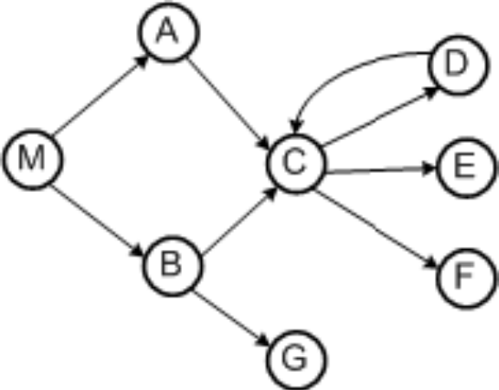
6.3.1 Call Graph
A call graph is a directed graph in which a node represents a function, a component, or a method.
An edge between two nodes A and B means that A may invoke B
Programmers use call graphs to understand the potential impacts that a software change may have.
An example call graph has been shown in Figure 6.7
Let P be a program, G be the call graph obtained from P, and p be some procedure in P
A key assumption in the call graph-based technique is that some change in p has the potential to impact changes in all nodes reachable from p in G.
Figure 6.7 Example of a call graph ©IEEE, 2003
Notes:
Handouts

Slide 17
6.3.1 Call Graph
The call graph-based approach to impact analysis suffers from many disadvantages as follows:
  impact analysis based on call graphs can produce an imprecise impact set. For example, in Figure 6.7, one cannot determine the conditions that cause impacts of changes to propagate from M to other procedures.
  impact propagations due to procedure returns are not captured in the call graph-based technique. Suppose that, in Figure, E is modified and control returns to C.. Now, following the return to C, it cannot be inferred whether impacts of changing E propagates into none, both, A, or B.
Figure 6.7 Impact analysis process ©IEEE, 2003
Notes:
Handouts

Slide 18
6.3.1 Call Graph
Let us consider an execution trace as shown in below.
  M B r A C D r E r r r r x. Where r and x represent function returns and program exits.
The impact of the modification of M with respect to the given trace is computed by forward searching in the trace to find:
  procedures that are indirectly or directly invoked by E; and
  procedures that are invoked after E terminates.
One can identify the procedures into which E returns by performing backward search in the given trace.
For example, in the given trace, E does not invoke other entities, but it returns into M, A, and C.
Due to a modification in E, the set of potentially impacted procedures is {M,A,C, E}.
Figure 6.7 Impact analysis process ©IEEE, 2003
Notes:
Handouts

Slide 19
6.3.2 Program Dependency Graph
In the program dependency graph (PDG) of a program:
  (i) each simple statement is represented by a node, also called a vertex;
  (ii) each predicate expression is represented by a node.
There are two types of edges in a PDG: data dependency edges and control dependency edges.
Let v_{i} and v_{j} be two nodes in a PDG.
If there is a data dependency edge from node v_{i} to node v_{j} , then the computations performed at node v_{i} are directly dependent upon the results of computations performed at node v_{j} .
A control dependency edge from node v_{i} to node v_{j} indicates that node v_{i} may execute based on the result of evaluation of a condition at v_{j} .
Notes:
Handouts

Slide 20
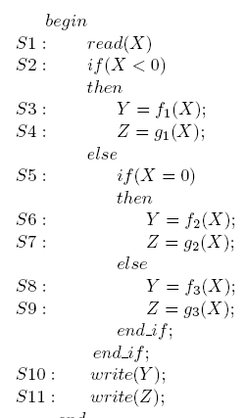
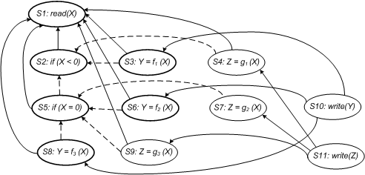
6.3.2 Program Dependency Graph
Figure 6.10shows the PDG of the program given in Figure 6.9.
Data dependencies are shown as solid edges, whereas control dependencies are shown as dashed edges.
Figure 6.9 Example program ©ACM, 1990
Figure 6.10 Program dependency graph of the program in Figure 6.9
Notes:
Handouts

Slide 21
6.3.2 Program Dependency Graph
Static Program Slice
A static program slice is identified from a PDG as follows:
    for a variable var at node n, identify all reaching definitions of var.
    find all nodes in the PDG which are reachable from those nodes.
    The visited nodes in the traversal process constitute the desired slice.
Consider the program in the previous slide and variable Y at S10.
First, find all the reaching definitions of Y at node S10 – and the answer is the set of nodes {S3, S6 and S8}.
Next, find the set of all nodes which are reachable from {S3, S6 and S8} – and the answer is the set {S1, S2, S3, S5, S6, S8}.
In the program dependency graph the nodes belonging in the slice have been identified in bold.
Notes:
Handouts

Slide 22
6.3.2 Program Dependency Graph
Dynamic Slice
A dynamic slice is more useful in localizing the defect than the static slice.
Only one of the three assignment statements, S3, S6, or S8, may be executed for any input value of X.
Consider the input value −1 for the variable X.
For −1 as the value of X, only S3 is executed.
Therefore, with respect to variable Y at S10, the dynamic slice will contain only {S1, S2 and S3}.
Notes:
Handouts

Slide 23
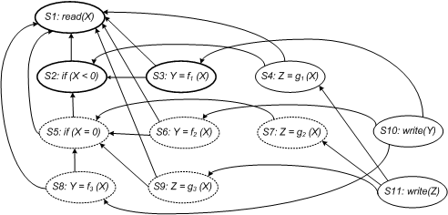
6.3.2 Program Dependency Graph
Dynamic Slice
Figure 6.11 illustrates how a dynamic slice is obtained from the program with respect to variable Y at the end of execution.
For the case X = −1, the executed nodes are: < S1, S2, S3, S4, S10, S11 >.
Initially, all nodes are drawn with dotted lines.
If a statement is executed, the corresponding node is made solid.
Next, beginning at node S3, the graph is traversed only for solid nodes.
Node S3 is selected because the variable Y is defined at node S3.
All nodes encountered while traversing the graph are represented in bold.
The desired dynamic program slice is represented by the set of bold nodes {S1, S2, S3}.
Figure 6.11 Dynamic program slice for the code in the figure 6.9, test case X= -1 with respect to a variable Y
Notes:
Handouts

Slide 24
6.4 Ripple Effect
Haney introduced the concept of ripple effect in the early 1970s.
From the functional and performance perspectives, Yau, Collofello and McGregor defined the concept of ripple effect in 1978.
They viewed ripple effect as a complexity measure to compare changes to source code.
In the scheme of Yau et al., ripple effect is computed by means of error flow analysis.
In error flow analysis, definitions of program variables involved in a change are considered to be potential sources of errors.
Notes:
Handouts

Slide 25
6.4 Ripple Effect
The ripple effect viewed as a complexity measure to compare changes to source code.
In the scheme of Yau et al., ripple effect is computed by means of error flow analysis.
Inconsistency can propagate from those sources to other variables in the program.
The other sources of errors are successively identified until error propagation is no more possible.
This work was later extended to include stability measure.
Stability reflects the resistance to the potential ripple effect which a program would have when it is changed.
Notes:
Handouts

Slide 26
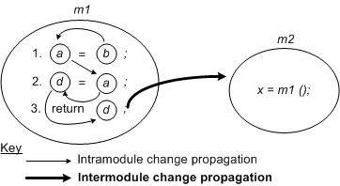
6.4.1 Computing Ripple Effect
Contained in module m1 of Figure 6.12, consider the three lines of code referring to variables a, b, and d.
A change in the value of b will impact a in line (1), and it will propagate to a in line (2).
Variable a affects variable d in line (2) and this will propagate to variable d in line (3).
Based on the above example, intramodule change propagation is defined as the propagation of changes from one source code line in a module to another source code line within the same module.
Figure 6.12 Intramodule and intermodule change propagation ©Wiley, 2001
Notes:
Handouts

Slide 27
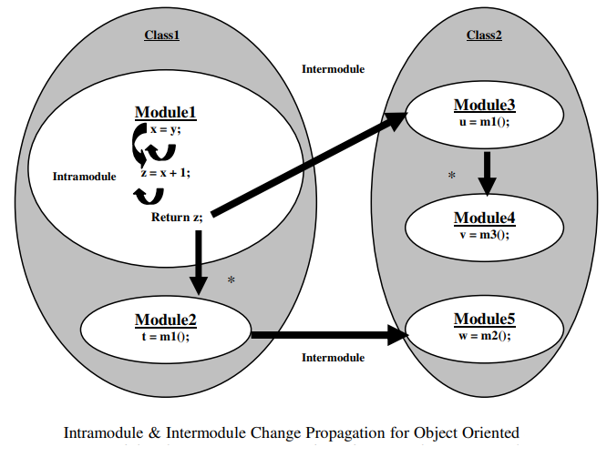

Slide 28
6.4.1 Computing Ripple Effect
Propagation of values of variables in one module to variables in a different module is referred to as intermodule change propagation.
Intermodule change propagation of values of a variable w occurs in the following ways:
  If w is a global variable, then a change made to w by one module is seen by another module accessing w.
  If w is an input parameter in a call to a second module, then values of w are propagated from the caller to the callee.
  If w is an output parameter, then its value propagates from the module that makes an output to the module that accepts the output.
Now we examine the code segment in Figure 6.12.
Variable d propagates to any module that calls m1, because d appears in the return statement.
If variable a is global, its appearance on the left-hand-side of an assignment statement causes its value to be propagated to any module that uses variable a.
Notes:
Handouts

Slide 29
6.4.1 Computing Ripple Effect
A matrix V_{m} is used to represent the initial starting points for intramodule change propagation.
The matrix records the following five conditions of the module’s variable x for all x:
  x is defined in an assignment statement.
  x is assigned a value in a read input statement.
  x is an input to an invoked module.
  x is an output from an invoked module.
  x is a global variable.
In V_{m}, variable definitions are uniquely identified.
Variable occurrences satisfying any of the five conditions – defined, assigned, input, output, and global – are denoted by “1”; otherwise, an occurrence is denoted by “0”.
the notation x^{d}_{i} means that the variable x has been defined at line (i).
Similarly, the notation x^{u}_{i} means that the variable x has been used at line (i).
Notes:
Handouts

Slide 30


6.4.1 Computing Ripple Effect
In module m₁, variable a is global and it is considered to be defined. Matrix V_{m1} for the lines of code in m₁ is expressed as:
A zero-one (0−1) matrix Z_{m} indicates values of what variables propagate to other variables in the same module.
Individual occurrences of variables are denoted by rows and columns of Z_{m}.
The source code of module m₁ results in the following matrix:
It is easy to observe that Z_{m1} is both reflexive and transitive.
The reflexive property implies that every variable propagates to itself. whereas transitivity means that if v₁ propagates to v₂ and v₂ propagates to v₃ then v₁ also propagates to v₃.
Notes:
Handouts

Slide 31
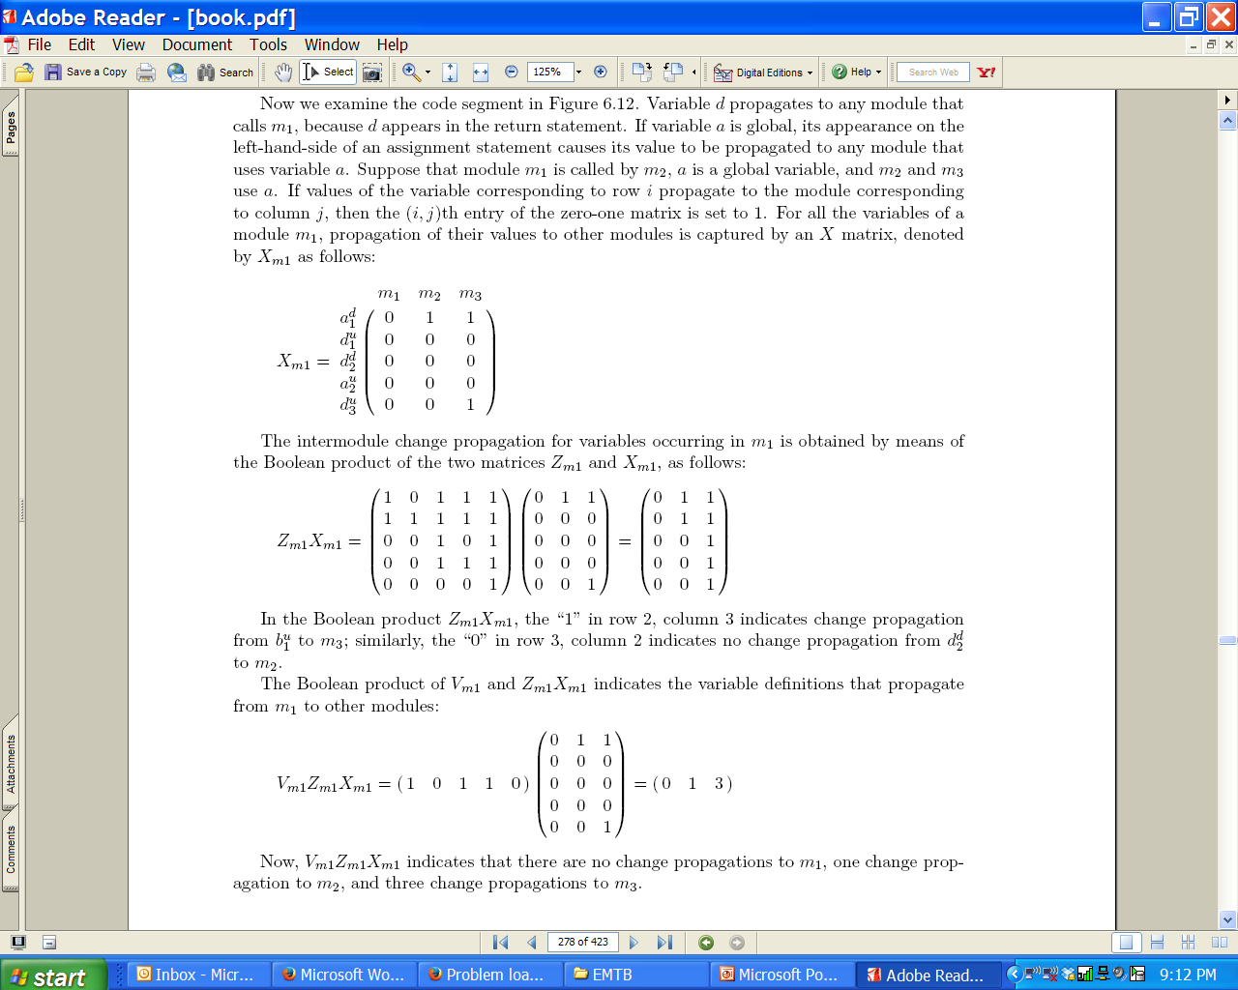
6.4.1 Computing Ripple Effect
Suppose that module m1 is called by m2, a is a global variable, and m₂ and m₃ use a.
If values of the variable corresponding to row i propagate to the module corresponding to column j, then the (i, j)th entry of the zero-one matrix is set to 1.
For all the variables of a module m₁, propagation of their values to other modules is captured by an X matrix, denoted by X_{m1} as follows:
Notes:
Handouts

Slide 32
6.4.1 Computing Ripple Effect
Concerning the complexity of making changes, the more complex a module is, the more resources are needed to change the module.
Therefore, a measure of complexity can be factored into the calculation of change propagation to obtain a measure of the complexity of modifying the definitions of variables.
The well-known McCabe’s cyclomatic complexity can be integrated with the ongoing computation of change propagation.
Notes:
Handouts

Slide 33
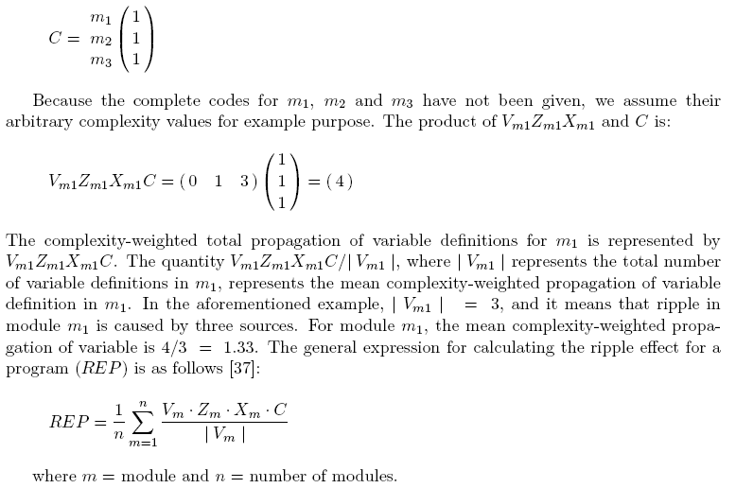
6.4.1 Computing Ripple Effect
A C matrix of dimensions 1×n is chosen to represent McCabe’s cyclomatic complexity, where n is the number of modules:
Notes:
Handouts

Slide 34
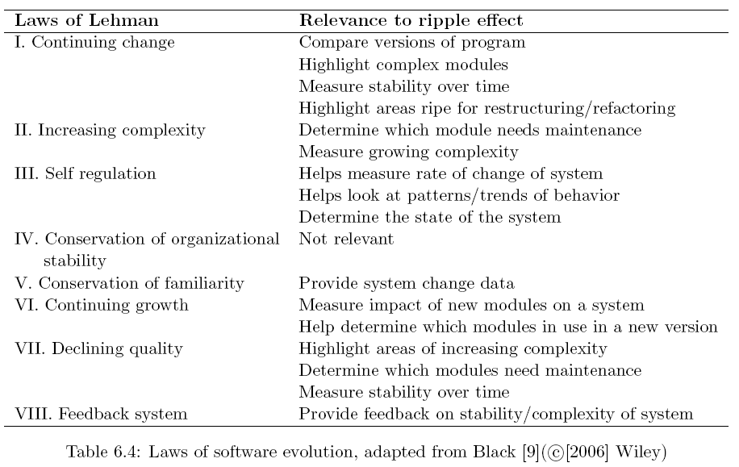
6.4.1 Computing Ripple Effect
Sue Black examined some links between ripple effect measurement, as summarized in the following table.
Notes:
Handouts

Slide 35
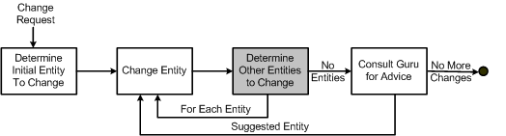
6.5 Change Propagation Model
Change propagation means that if an entity, say, a function, is changed, then all related entities in the system are accordingly changed.
Based on the work of Hassan and Holt, a change propagation model has been illustrated in Figure.
Figure 6.13 Change propagation model ©IEEE, 2004
Notes:
Handouts

Slide 36
Summary
General Idea
Impact Analysis Process
Dependency-based Impact Analysis
Ripple Effect
Change Propagation Model
Notes:
Handouts

